Slide 1
SHUNT TECHNOLOGIES

Slide 2
Introduction
Controversial topic – which shunt is best?
Confusion- how it works?
Knowing the principles will help in intelligent selection of device.

Slide 3
History
Hippocrates
First attempted ventricular puncture for HCP
Nulsen and Spitz
Pudenz
Ventriculojugular shunt –spring & ball.
Used silicone tubing
VP shunt = 1908

Slide 4
Shunt Resistances are Additive ?
R1 is negligible

Slide 5
Shunt Hydrodynamics
Flow rate = P/R
P = Driving pressure
R = Resistance to flow
Resistance from shunt tubing(Rt.)
Length and inner diameter of
the tubing(L)
Viscosity of the CSF .
Rt= 8nL/ π r⁴ (Poiseuille’s law)
n = coefficient of absolute viscosity.
Resistance from valve components (Rv.)
Its not constant in the range of
physiologic flow rates & a curved
flow relationship is seen.

Slide 6

Hydrodynamics contd.
The pressure gradient driving the flow in a
ventriculoperitoneal shunt system is determined by-
ΔP = IVP + hρg – OPV - DCP
ρ = density.
OPV = opening pressure of the valve.
DCP = distal cavity pressure.

Slide 7
Applied importance
Rt=8ηL/πr⁴
Kinking can reduce flow significantly.
Shortening distal catheter will alter dynamics.
ρgh
Higher flow rate in sitting and standing position= "Siphoning”
Air bubbles can cause failure.
For higher density CSF, low pressure systems work better.

Slide 8
Biomaterials
Biomaterials currently used include:
Silicone elastomer – catheters, valve housings / suture clamps, siphon devices, etc.
Polypropylene/Polysulfone/Nylon/Polyethersulfone – valve housings/seats, needle stops, connectors, reservoirs.
Ruby/Sapphire – valve pins, balls, seats
Titanium/Stainless Steel – valve housings, needle stops
Tantalum – radiopaque markers.
Barium – radiopaciofier (homogenous or stripe).

Slide 9
Shunt Systems
Shunt systems come in a variety of configurations and models but they have similar functional components:
  Valve Mechanisms – flow or differential
  Fixed, programmable, or variable settings
  Catheters
    Ventricular (proximal)
    Peritoneal/Atria (distal)
  Accessories
    Reservoirs, Siphon Devices
    Connectors, Filters, Pumping Chambers

Slide 10
Shunt Valves
Differential pressure valves
Flow regulated valves
Gravity actuated valves
Programmable valves

Slide 11
Differential pressure valve
Slit valves
Miter valve
Diaphragm v.
Ball in cone valve
Defined by their opening and closing pressure.
As the IVP goes above the valve opening pressure,
the valve opens to allow egress of CSF at a rate determined
by the resistance of the system, until the pressure falls below the closing pressure and flow of CSF ceases.

Slide 12
Slit valves
Proximal slit valves
Distal slit valves
Holter Hausner valve
Codman unishunt valve
Chhabra shunt.
They offer the least resistance to flow and in fact no significant difference in resistance can be measured between a tube with a distal slit valve and an equally long open ended tube.

Slide 13
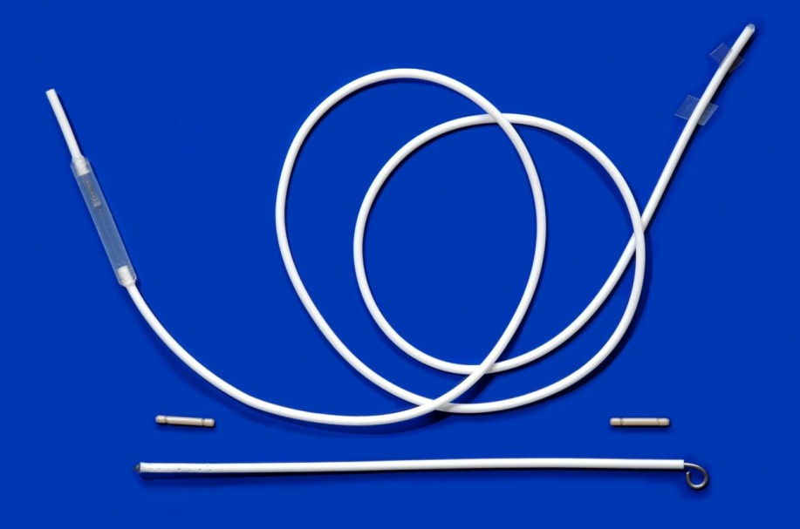
Chhabra shunt
Slit valve
Slit and spring valve system.
The systems are available in 2 ball, 3 ball, 4 ball range.
Catheters contain barium sulfate for x-ray detectability.
The ventricular catheter has tantalum tip.
Regulating valve contains a stainless steel sleeve and balls and a sapphire ball.

Slide 14
Diaphragm valve
Most commonly used type of valve.
Involve the deflection of a silicone membrane in
response to pressure in order to allow flow of CSF

Slide 15
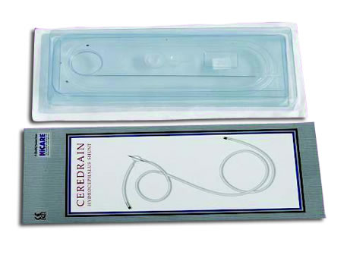
Diaphragm valve
Ceredrain
Ref: www.lifecarehll.com

Slide 16
Basic Valve Features
Valve mechanism of dissimilar materials
  Differential pressure mechanism
    When the sum of inlet and outlet pressure exceed a threshold value, valve opens and drains
Central reservoir for percutaneous CSF access
Plastic base for rigidity and stability
Non-metallic design

Slide 17
Button Valve
For neonatal use (premature infants)
Profile: 4 mm
Requires use of separate reservoir
No occluders

Slide 18
Differential Pressure Valve
In Reality
8 cm H₂0 (valve) + -48 cm H₂0 (distal catheter) =-40 cm H₂0
+ 8 cm H₂0
Medium Valve
IVP (Ventricles)
IVP = -40 cm H₂0
Siphoning
-48 cm
Shunt
Overdrains

Slide 19
Flow Regulated Valves
Contoured synthetic ruby
flow control pin that fits
inside a movable ruby ring
As the pressure increases ,
the ruby ring is deflected
downwards, the ruby ring
is tapered the flow aperture
decreases which increases
resistance and reduces flow.
If the pressure is further increased the ruby ring is further deflected down
until resistance is lowered to allow rapid increase in flow rate.

Slide 20
Flow Regulated Valves
Advantage
Flow regulated valves are less likely to be
associated with siphoning and over drainage
Disadvantages
Due to small orifice high chances of obstruction.
High resistance has a propensity to cause fluid
collections under the scalp in young children
unless they are nursed upright with a
compressive dressing

Slide 21
Gravity Actuated Valves
They attempt to prohibit or reduce
siphoning by increasing opening
pressure with the assistance of gravity.
Inlet valve = ball spring valve
and does not change resistance
with position
Outlet valve has a synthetic ruby ball
that sits in a conical seat and there are
three stainless steel balls that sit on top
of it which weigh it down in upright position and fall away in recumbent position.

Slide 22
Programmable valves
They are externally adjustable differential pressure valves.
Surgeon has the option of altering the opening pressure with an external device and thus altering the need for surgical shunt revision.
They are also susceptible to siphoning.

Slide 23
Programmable valves
They have an adjustable ball and spring mechanism. A step motor assembly.
Radiopaque markers.
Motor assembly can be adjusted with externally applied magnets.

Slide 24
Platform Stops
Platform stops inhibit rotor movement from one platform to the next
Need extra strong magnet to lift the rotor over the stop to the new platform

Slide 25
StrataVarius
Handheld instrument designed to be ambidextrous
Battery powered device (2-AA)
  100 uses
  Power-down after 3 minutes of idle time.
LCD readout screen
Portal for valve palpation and magnetic adjustment
Magnet is 2 times stronger

Slide 26
MRI Studies
Safe for use; “MRI Conditional”
  no movement of valve in tissue pocket
  no selective heating
  no effect on valve performance
MUST Reprogram after each MRI
  MRI will change the pressure setting

Slide 27
Indications for Programmable valve
Chronic slit ventricle syndrome
Premature infants who do not tolerate over drainage
NPH

Slide 28
Effects of siphoning
Tear bridging veins
SDH
Craniosynostosis
Slit ventricle
syndrome

Slide 29
To prevent siphoning
Change the shunt valve to one
with higher opening pressure
Use antisiphon device
Will only delay ventricular collapse
But will not prevent it.

Slide 30
Antisiphon device
Has a small diaphragm that reduces the
flow of CSF when the pressure inside the
shunt falls below the atmospheric pressure

Slide 31
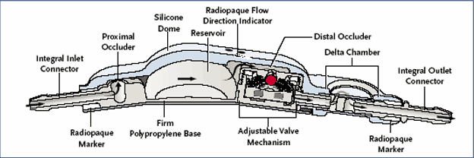
Delta Chamber
The Delta Chamber uses a hydrodynamic leverage ratio of 20:1 to reduce the effect of negative hydrostatic pressure, and allow the valve to operate in its specified Performance Level, regardless of body posture.
http://ebtplus.co.kr/images/product_img63.gif

Slide 32
Delta Valve Message
The Delta chamber senses both positive inlet pressure, and negative outlet pressure, and manages both.
The Delta chamber manages negative outlet pressure without adding significant resistance to the shunt.
The dissimilar material and recessed design of the Delta chamber diaphragms help to minimize the risk of compression from overlying tissue.

Slide 33

Siphon / Flow Control
SiphonGuard™ is a unique device designed to reduce the risk of CSF overdrainage complications.
Rugged
  No encapsulation or external pressure influence – flow not totally blocked
  Avoids damage due to errant needle
Unaffected by implant location
Available as an integrated or stand alone device.
Device is always open unlike other on and off devices.
Codman-nonprogrammable.jpg
Notes:
I would like to transition over to our siphon control device which we call SIPHONGUARD. In effect, we should have named this flowguard, because the device is always open, unlike the other anti siphon control devices which are “on/off” devices.
(Review slide contents to describe the features, benefits of our SIPHONGUARD)

Slide 34
Advancements in biomaterials
Antibiotic impregnated shunt tubings.
Coated silicone tubings for converting them into hydrophilic and more lubricious material.

Slide 35
Antibiotic impregnated shunts
Bacteria In Shunting
  Most common bacteria in shunt infections?
    S. epidermidis
    S. aureus
    Coryneformis
    Streptococci
    Enterococci
Account for approx. 77% of shunt infections.

Slide 36
Internal or External ?
Internal
Majority
S. epidermidis or Coryneformis
External
Minority
Wound infection complicated by foreign body
S. aureus

Slide 37
Contd..
Internal Shunt Infection
The organisms start to multiply
And they produce extracellular slime
This can, in time, completely block the shunt

Slide 38
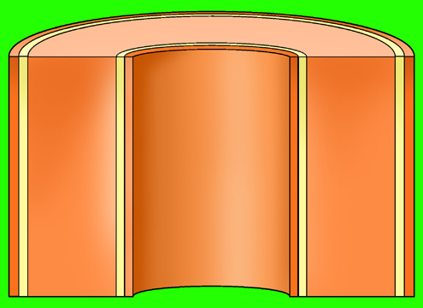

Contd..
How Do They Work?
CSF
Due to the concentration difference between the catheter and the external environment, there is a
positive diffusion gradient
which causes the drugs to slowly diffuse out of the silicone.
CSF
The concentration of drugs at the surface of the catheter is high enough to inhibit colonization.
CSF

Slide 39
Precaution
Pre Implant Technique
Surgeon should not pre soak Bactiseal in saline or antibiotic solutions prior to implantation because the diffusion process will be activated.

Slide 40
Reduction in infection
Significant reduction in shunt infection rate with antibiotic impregnated shunt.(from 6.5% to 1.2%).
P value- 0.0015.
Chris X et al, dept of NS, Vic. Australia.
J. Of clinical neurosciences JUNE 2007.

Slide 41
BioGlide
BioGlide is a covalently-bonded hydrogel that aids with ease of insertion, reduces bacterial adhesion, and absorbs water-soluble antibiotic solutions
Created to address the issue of “infection”

Slide 42
BioGlide
We can say:
  Hydrophilic, lubricious surface facilitates insertion
  Smoother surface than non BioGlide treated surface
We should be cautious saying:
  Reduced Bacterial Adhesion
  Absorption of Antibiotics

Slide 43
Specific requirements
Posthemorrhagic hydrocephalus
of the premature
High brain turgor
patients (achondroplasia,
Crouzons, others)
Low brain turgor
patients (NPH)
Pressure differential valve of
ball-in-cup or diaphragm design
High pressure shunts
May even need valves
in series.
LP shunt with ASD

Slide 44
Cost of various shunt systems
No. | Name | Rupees
1 | Codman programmable | 45,000
2 | Medtronic programmable | 39,000
3. | Diamond (vygon) | 17,000
4. | Bactiseal | 12,000
5. | Phoenix(vygon) | 5,000
6. | Ceredrain | 1,300
7. | Chhabra | 1,240

Slide 45
Indian Scenario
“The inexpensive Chhabra shunt in comparison to Codman shunt had no statistically significant diff in outcome”(J Neurosurgery {peds 4}102:358-362,2005)

Slide 46
Valve design trials
“Multicentre randomized trials of CSF shunt valve design have failed to demonstrate any difference among the valves in cases of shunt failure.”
DRAKE Jm et al-RCT of CSF valve design in pediatric pts. Neurosurgery 43:294-305. 1999
Pollack et al- RCT of a programmable valve versus a conventional valve for patients with HCP. Neurosurgery 45:1399-1408,1999.
Exception = Antibiotic impregnated shunt.

Slide 47
Unmet Medical Needs
Shunting
“Smart Shunting”
  Intracranial Pressure Sensing
  CSF Shunt Flow Sensing
  Internal Feedback Control
Reduction of Shunt Infection Rates
Self-healing properties and the ability to elongate with patient growth, may be characteristic of future biomaterials.

